Slide 1
HTML+ CSS PRINCIPLES
Getting started with web design the right way

Slide 2
HTML : a brief history
^{❶}1960s : ARPANET is developed... It is the first “packet-switching” network using TCP/IP protocol and is a precursor to World Wide Web.
http://en.wikipedia.org/wiki/ARPANET

Slide 3
HTML : a brief history
^{❷}HTML language is invented in early 1980s
http://www.w3.org/History.html

Slide 4
HTML : a brief history
^{❸}In the 1980s desktop computing also became a much more common tool for businesses and consumers.

Slide 5
HTML : a brief history
^{❹}1989-90 the “World Wide Web” is developed by Tim Berners-Lee along with the first visual web browser…
http://www.w3.org/History/1989/proposal.html

Slide 6
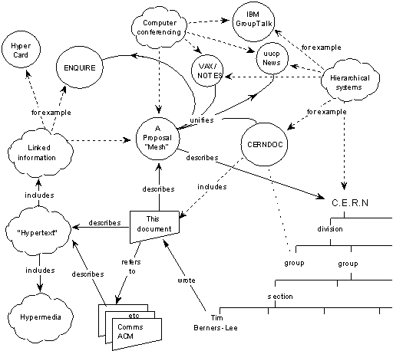
The idea:

Slide 7
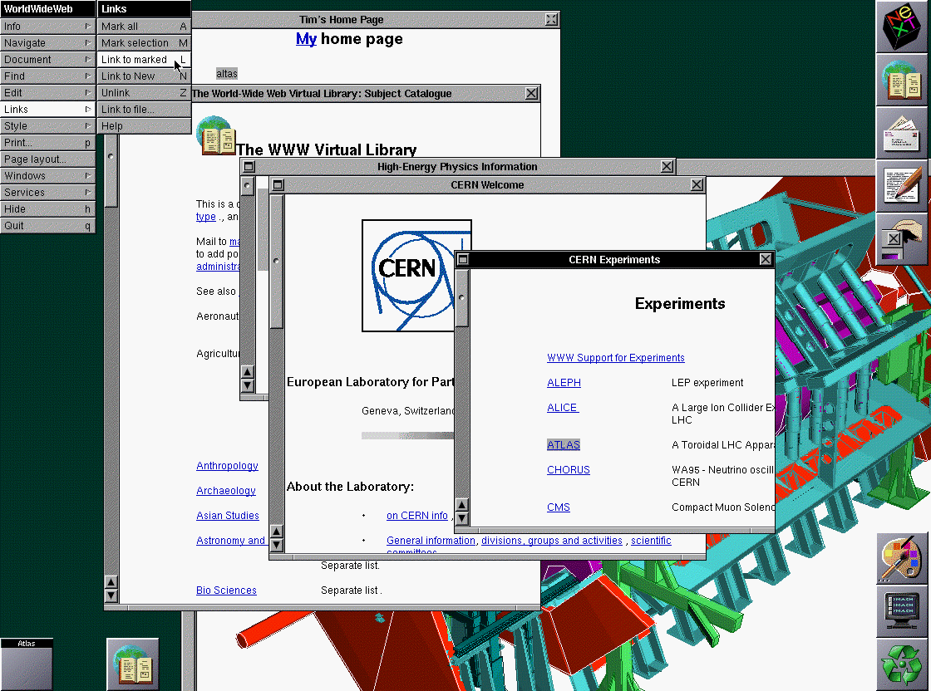
The browser:

Slide 8
HTML : a brief history
^{❺}More users + new addition of commercial uses created more complexities and greater need for standards.

Slide 9
HTML : a brief history
^{➅}2002: XHTML was developed for use with stricter standards and a more flexible framework to incorporate XML data files.

Slide 10
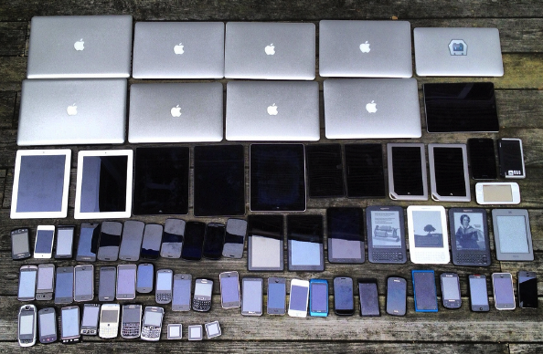
HTML : a brief history
^{➆}Then this started happening:

Slide 11
HTML : a brief history
^{➇}2008: HTML5 is introduced. It moves away from xml but offers database integration, semantic markup, javascript integration, and and better video capabilities.

Slide 12
HTML
Hypertext Markup Language
Current version of HTML is HTML5. Prior to HTML5 the standard was XHTML, which was the first to offer strict semantic markup and a focus on separating “presentation from structure.”

Slide 13
What HTML looks like
display view vs. code view

Slide 14
HTML > display
Here’s what we
see as a viewing
audience:

Slide 15
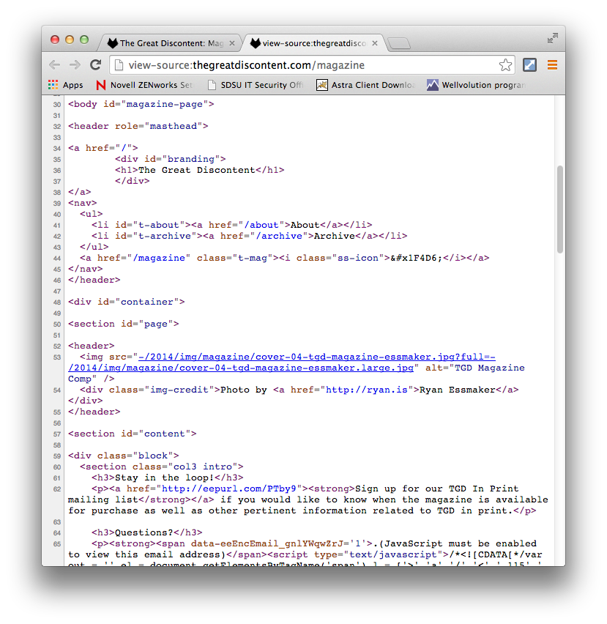
HTML > code
Here’s what we
do as web
designers and
developers:

Slide 16
HTML > where to start
HTML is based on the use of TAGs.
TAGs are the beginnings and endings of element declarations. They tell the browser how to process the given data.

Slide 17
HTML > how to start
The basic anatomy of a TAG:
<tagname>Blah blah blah</tagname>
(BTW, this is a dummy, not-real example)

Slide 18
HTML > how to start
It could also look like this:
<tagname>
Blah blah blah
</tagname>
(Still not-real)

Slide 19
HTML > how to start
It could also look like this:
<tagname>
Blah blah blah
</tagname>
Almost all tags have an opening AND closing tag. The only difference is that the closing tag starts with a “/” forward-slash.

Slide 20
HTML > tag examples
<p>This is where you type the paragraph text you want to show up on the screen.</p>
(This is a real example of a “paragragh” tag)

Slide 21
HTML > tag examples
<h1>I’m the most important heading</h1>
<h2>I’m important heading level #2</h2>
…
<h6>Headings go down to a level #6</h6>
(These are real examples of “heading level” tags.)

Slide 22
HTML > tag examples
<ul> <li>List item one goes here</li>
<li>List item two goes here</li> </ul>
(These are real examples of “unorded list” and “list item” tags.)

Slide 23
HTML > tag examples
…and the TAG list goes on:
<html> <head> <title> <base> <link> <meta> <style> <body> <section> <nav> <article> | <aside> <header> <footer> <address> <p> <hr> <pre> <blockquote> <ol> <ul> <li> | <dl> <dt> <dd> <figure> <figcaption> <div> <a> <em> <strong> <small> | <cite> <q> <abbr> <data> <code> <img> …AND MANY MANY MORE.

Slide 24
HTML > tag examples
A TAGcan also be referred to as an
ELEMENT. Here is a GREAT resource list of HTML5 elements with explanations of each one is used:
https://developer.mozilla.org/en-US/docs/Web/Guide/HTML/HTML5/HTML5_element_list

Slide 25
HTML > attributes
A TAGcan also have ATTRIBUTES:
<a href=“http://gmail.com”>Go to GMAIL</a>

Slide 26
HTML > attributes
ATTRIBUTES are information within the tag, defining the tag. Different tags have different attribute options.
<a href=“http://gmail.com”>Go to GMAIL</a>

Slide 27
HTML > values
AVALUE is what pinpoints the ATTRIBUTE to more specific information.
<a href=“http://gmail.com”>Go to GMAIL</a>

Slide 28
HTML > tag, attribute, value
In this example below, we have an <a> tag, which is an “anchor” link. But we need to know where the link will go, so we give it an attribute, “href”, which stands for hyper-reference. And that href will take us to the value of “http://gmail.com” when clicked. What the viewer sees as a clickable link is inside the <a></a> tags, “Go to GMAIL”.
<a href=“http://gmail.com”>Go to GMAIL</a>

Slide 29
HTML > nesting tags
To make pages, we have to “nest” TAGs:
<article>
<header>
<h1>How Cells Multiply</h1>
</header>
<p>Our cells are amazing. They really can multiply…</p>
</article>

Slide 30
HTML > nesting tags
…and nest them properly:
<p>
<a href=“contact.html”>Contact Us</a>
</p>
<p>
<a href=“contact.html”>Contact Us</p>
</a>
✓
X

Slide 31
SPEAKING OF WHICH…
Let’s look at the basic, required parts of any HTML page….

Slide 32
Minimum HTML5 requirements
<!DOCTYPE html>
<html>
<head>
<title>Title goes here</title>
</head>
<body>
</body>
</html>

Slide 33
What is <!DOCTYPE> ???
<!DOCTYPE html>
<html>
<head>
<title>Title goes here</title>
</head>
<body>
</body>
</html>

Slide 34
What is <!DOCTYPE> ???
<!DOCTYPE html>
The “doctype” announces to a browser which version of HTML it is using. This helps the browser know what to expect and how to behave.
Without a “doctype”, browsers go into “quirks mode” and can interpret code unpredictably.

Slide 35
The <html> tag
<!DOCTYPE html>
<html>
<head>
<title>Title goes here</title>
</head>
<body>
</body>
</html>

Slide 36
The <html> tag
<html>…</html>
The “html” tag represents the root of an HTML or XHTML document. All other elements (except “doctype”) must be descendants of this element.

Slide 37
The <head> tag
<!DOCTYPE html>
<html>
<head>
<title>Title goes here</title>
</head>
<body>
</body>
</html>

Slide 38
The <head> tag
<head><title>…</title></head>
The “head” tag contains a collection of metadata about the document, including links to, or definitions of, scripts and style sheets. At a minimum, it MUST contain a “title” tag.

Slide 39
The <title> tag
<!DOCTYPE html>
<html>
<head>
<title>Title goes here</title>
</head>
<body>
</body>
</html>

Slide 40
The <title> tag
<title>Title goes here</title>
Defines the title of the document, shown in a browser's title bar or on the page's tab.
It can only contain text. Nested HTML tags will not be interpreted.

Slide 41
Finally, the <body> tag
<!DOCTYPE html>
<html>
<head>
<title>Title goes here</title>
</head>
<body>
</body>
</html>

Slide 42
Finally, the <body> tag
<body>…</body>
Contains the content of an HTML document that is visually displayed in the browser’s viewport/window.
There is only one <body> element in a document.

Slide 43
A technical recap
<!DOCTYPE html>
<html>
<head>
<title>Title goes here</title>
</head>
<body>
</body>
</html>

Slide 44
A metaphorical recap
HTML tags are fairly intuitive. An easy way to remember the basic parts is to humanize a page:
Doctype = laws governing behavior
<html> = the whole person
<head> = the brain that gathers information
<title> = name / identity a person calls one’s self
<body> = the physical representation and behaviors of the person

Slide 45
SPEAKING OF INTUITIVE…
Let’s talk about “SEMANTIC” html markup.

Slide 46
Semantic
adjective \si-ˈman-tik\
: of or relating to the meanings of words and phrases

Slide 47
Semantic tags in HTML
HTML tags are imbued with meaning.
They should not be arbitrarily assigned.
They have meaning outside of visual representation.
Visually impaired people can still understand the meaning of sections in a page with semantic markup.
Search engines can too.

Slide 48
A “semantic” case study
Imagine that you are reading a newspaper but there are no headings, no margins, no indents, no bold, no italics, no paragraph separations, etc.
IT’S JUST TEXT…

Slide 49
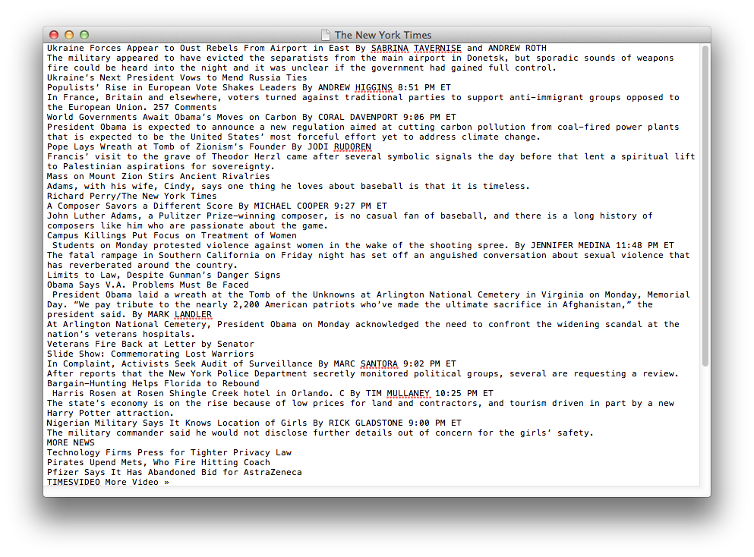
A “semantic” case study
LIKE THIS:

Slide 50
A “semantic” case study
Without meaningful hierarchy, no one would want to read through that page because it would be a laborious experience.
That is how search engines and blind people experience pages with poor semantic markup.

Slide 51
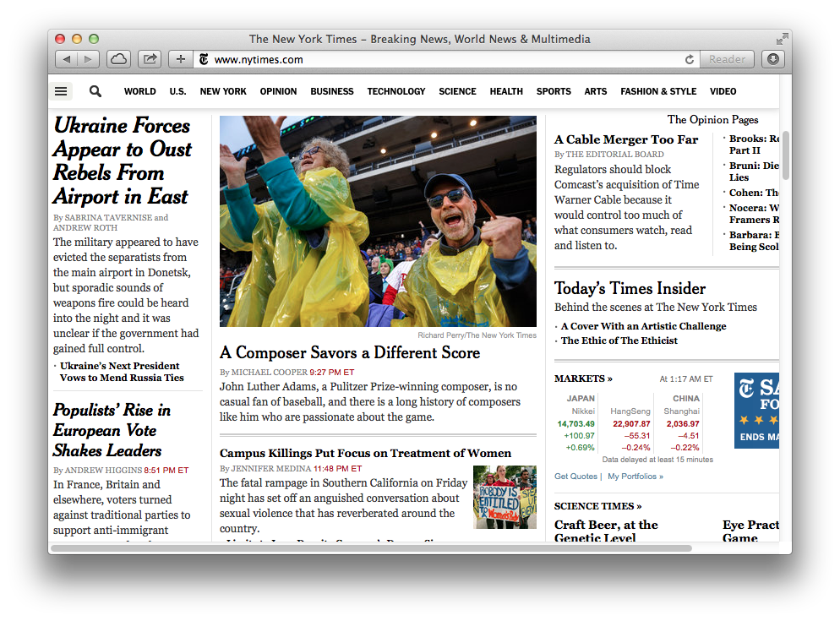
A “semantic” case study
SAME SITE, BUT BETTER EXPERIENCE:

Slide 52
An argument for semantics
This brings us to the importance of STRUCTURE
vs.
PRESENTATION

Slide 53
Structure vs. Presentation
The STRUCTURE of an HTML document should be a well-crafted page that can be understood semantically by search engines and assistive devices like screen readers (aids for the blind).

Slide 54
Structure vs. Presentation
Additionally, STRUCTURE also incorporates the actual CONTENT of the document (e.g. headings, article text, links, pictures, video, etc).

Slide 55
Structure vs. Presentation
The PRESENTATION half of the coin uses VISUAL STYLING to communicate the semantics to people not using screen readers.
This is accomplished by pairing CSS with the structure.

Slide 56
Structure vs. Presentation
To make a point about STRUCTURE vs. PRESENTATION, let’s revisit the page with no semantic markup or structure at all:

Slide 57
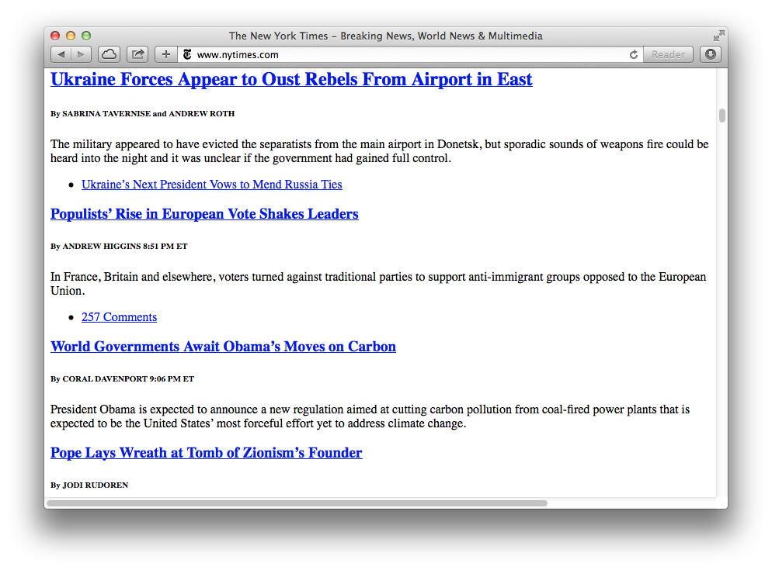
Structure vs. Presentation
By simply adding semantic markup STRUCTURE we can have a meaningful page readable by search engines, screen readers, and even people:

Slide 58
Structure vs. Presentation
Now let’s add CSS styling to it for better visual PRESENTATION:

Slide 59
Structure vs. Presentation
So, you might ask:
Is there ever a time to use non-semantic tags?
SURE.

Slide 60
<div> <span>
The only two generic html tags that have no semantic meaning at all.

Slide 61
<div> and <span>
There are occasions when you need to use generic tags for PRESENTATION purposes and really don’t want a tag container to have any special meaning.
That is when you use either <div> or <span>.

Slide 62
What’s the difference between the two?
<div>
A “block-level” container tag.
“Block-level” elements take up the entire width of a line unless otherwise specified in the CSS.
<span>
An “inline” container tag.
“Inline” elements take up only as much space as necessary and can sit side-by-side with other “inline” elements within a line.

Slide 63
<div> “block” example
<div>div example 1</div>
<div>div example 2</div>
div example 1
div example 2

Slide 64
<span> “inline” example
<span>span example 1</span>
<span>span example 2</span>
span example 1
span example 2

