Slide 1
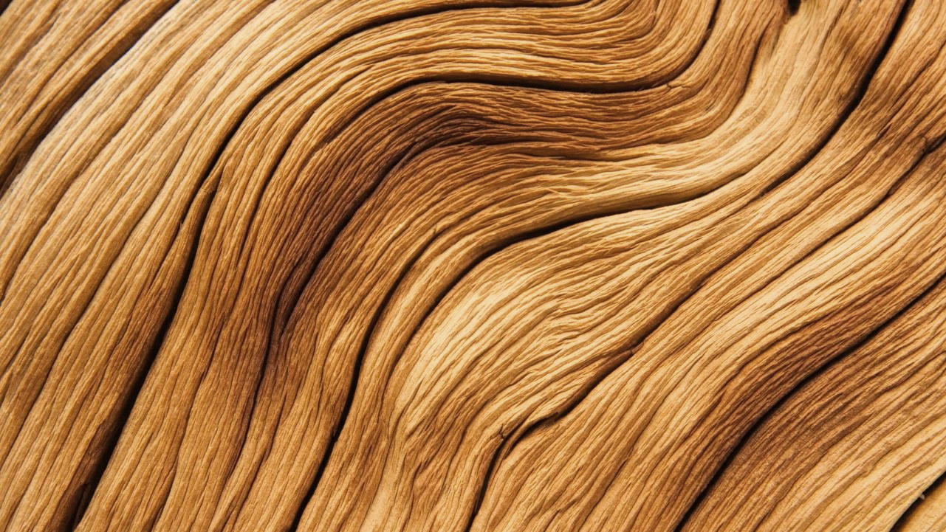
Haptic Works
-Made to be felt
Type: Brand Indent
Duration: ~ 8 seconds
Goal: To express the essence of Haptic Works — tactility, calm focus, and connection through touch — by contrasting the feeling of smooth vs. carved surfaces and engraving the brand logo directly into the material.
Keywords: tactile, grounded, calm, sensory, handcrafted

Slide 2
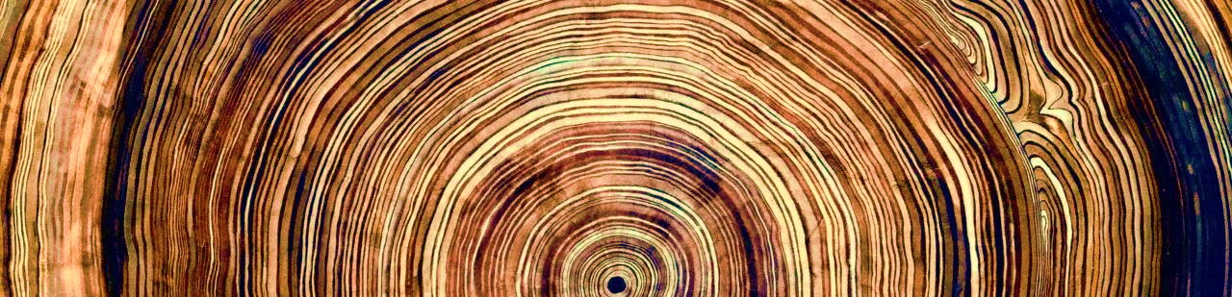
Visual Focus
Close-ups of walnut wood grain, carved texture, hand touching surface, faint smoke transitions, engraving marks.
Minimal light: warm directional light, matte tone, no haze or dust particles.

Slide 3
Typography
Logo: MBF Royal Regular (uppercase)
H1: OGG Regular (Warm Clay or Charred Pine, tracking +20–30)
H2 / H3: Poppins Regular or Medium (Charred Pine or Sage Moss, sentence case)
Tagline: OGG Italic (Honey Amber or Warm Clay)

Slide 4
Color Palette
Warm Clay — #B98A6D
Soft Ash — #D8CFC6
Sage Moss — #7A8574
Honey Amber — #D2A25F
Charred Pine — #2C2B27

Slide 5
storyboard
Slide | Scene Description | Audio / Sound Design Notes (Optional)
1 | Fade in from black. A smooth walnut surface fills the frame under warm, directional light. | Optional faint ambient room tone or silence.
2 | A hand enters frame, slowly gliding across the flat surface. The lighting highlights the calm, even grain. | Option: quiet, natural skin-on-wood sound or nothing at all.
3 | Close-up on fingertips — the movement is smooth and confident. The shot emphasizes stillness and control. | Remain silent here; visual rhythm carries the moment.
4 | Cut — same hand now touches a carved surface. The texture visibly changes how the fingers move, guiding their path. | Optional light texture glide sound, almost inaudible.
5 | The hand continues to trace the carved lines — movement feels guided, responsive, natural. | Silence or very soft breath cue; tactile focus only.
6 | A thin wisp of smoke enters frame, rising gently between the carving and the camera. | Option: faint whoosh or soft exhale — only if it feels natural.
7 | The smoke fills the frame, creating a clean, direct transition. | Fade to silence if using any sound.
8 | The logo begins to engrave into the carved surface — slow, deliberate, clean motion. | Optional single etching or carving sound timed to the movement (minimal, low volume).
9 | The logo completes — “HAPTIC WORKS” surrounded by a circular line that subtly resembles a fingerprint or drawn gesture. | One soft click or chime if you want punctuation; otherwise pure silence.
10 | Tagline Made to Be Felt fades in below. The image holds briefly, then fades to black. | Optional faint breath out or full silence. End on stillness.

Slide 6
Self Shoot Footage List
Shot # | Description | Angle / Detail | Notes
1 | Hand on flat wood surface | Macro side light | Smooth texture
2 | Hand on carved surface | Macro | Guided movement
3 | Smoke transition | Soft focus | Natural exhale
4 | Logo engraving | Close-up | Text appears etched
5 | Final logo hold | Centered | Circle + tagline fade

Slide 7
Equipment Procurement
Camera: DSLR or mirrorless (manual focus for texture shots)
Tripod: Yes — stability for macro focus
Lighting: Single warm LED; optional reflector
Audio: Lavalier or shotgun mic for texture sounds (optional)
Other: Small fan or vapor device for smoke transition
Plan: borrow from campus media lab or shoot using available natural light + tripod.

Slide 8
Location Scouting
Location: Home workshop or controlled indoor studio setting.
Lighting Notes: One directional light to emphasize grain texture; neutral background.
Surface: Walnut 10" × 10" × 2" block with carving pattern (your actual piece).
Why: Provides direct tactile authenticity to the brand — same material used in Haptic Works products.

Slide 9
Audio to Capture
Soft hand-on-wood sound (recorded with phone mic)
Light exhale or whoosh for smoke transition
Etching sound timed to logo engraving (optional)
Single chime or click for logo completion

Slide 10
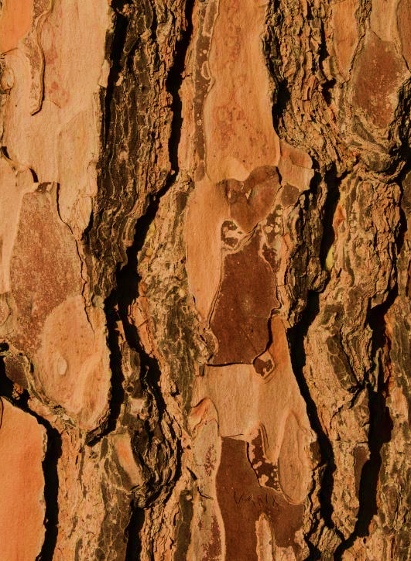
Summary
“This piece introduces Haptic Works through the language of touch. The contrast between smooth and carved surfaces mirrors how design can guide movement and emotion. Every choice — from the engraving motion to the circle form of the logo — reinforces the brand’s philosophy: Made to Be Felt.”

