Slide 1
AN Artist Above ALL
with Brendon Rosenkranz
Produced by Tratyn Bush

Slide 2
time:0:11
Shot 1
Effects - Soft fade In to Title Frame
Audio - Fade in to track (under the watch of the sun) Only the beginning
Script - Stay on Title frame while music fully fades in. A soft fade out transition into opening bee reel.

Slide 3
TIME:0:22
Shot 2
Effects - A receiving soft transition from Shot #1. Introduction of film flare effect.
Audio - Continuing of track from Shot #1.
Script - A b-roll of Brendon walking through different environments. Including some shots of boots walking and bottom of guitar

Slide 4
TIME:0:33
Shot 3
Effects - Fade into a bright film flare
Audio - Intro to Interview with Brendon.
Script - Brendon introduces himself to the audience and the interview begins.

Slide 5
TIME:0:44
Shot 4
Effects - Cut to ( Content ) Fade out to black
Audio - Brendon speaking upon the first question asked ( interviewers voice wont be heard )
Script - A close up of the reflection on a guitar in the studio as Brendon sets up to work.

Slide 6
TIME:0:55
Shot 5
Effects - Fade in
Audio - Light finger strums on guitar strings as background noise to interview words
Script - Close up b-roll of Brendon setting up.

Slide 7
TIME:1:06
Shot 6
Effects - No effects
Audio - Interview Section w/ Brendon, Questions 1-3
Script - About 1-2 shots of interview with Brendon

Slide 8
TIME:1:17
Shot 7
Effects - No effects
Audio - Interview Section w/ Brendon, Questions 1-3
Script - About 1-2 shots of interview with Brendon

Slide 9
TIME:1:28
Shot 8
Effects - Fade in with black. Film Flare effect into fade to white from scene to scene
Audio - Second track starts ( Chichen Itza Demo)
Script - Guitar being strummed by Brendon, with cut scenes to nature hikes in shadowy areas.

Slide 10
TIME:1:39
Shot 9
Effects - Film Flare effect into fade to white from scene to scene
Audio - Second track starts ( Chichen Itza Demo)
Script - Nature B-roll

Slide 11
TIME:1:50
Shot 10
Effects - Cross Fade with White
Audio - Fade into audio of Brendon speaking in interview Questions 4-9.
Script - A b-roll of Brendon playing in the studio. Cut to Brendon speaking on key words.

Slide 12
TIME:2:01
Shot 11
Effects - Fade to different shots
Audio - Brendon speaking in interview Questions 4-9.
Script - A b-roll of Brendon playing in the studio. Cut to Brendon speaking on key words.

Slide 13
TIME:2:12
Shot 12
Effects - Fade to different shots
Audio - Brendon speaking in interview Questions 4-9.
Script - A b-roll of Brendon playing in the studio. Cut to Brendon speaking on key words.

Slide 14
TIME:2:23
Shot 13
Effects - Fade to different shots
Audio - Brendon speaking in interview Questions 4-9.
Script - A b-roll of Brendon’s Interests

Slide 15
TIME:2:34
Shot 14
Effects - Cut to black from previous Shot
Audio - Audio from different shows played by Brendon
Script - Clips shots of different shows Brendon played

Slide 16
TIME:2:45
Shot 15
Effects - Cut to black from previous Shot
Audio - Audio from different shows played by Brendon
Script - Clips shots of different shows Brendon played

Slide 17
tIME:2:56
Shot 16
Effects - Cut to black from previous Shot
Audio - Audio from different shows played by Brendon
Script - Clips shots of different shows Brendon played

Slide 18
tIME:3:07
Shot 17
Effects - Fade in from Black (Cut to black from last shot)
Audio - Third Song ( Sample Song created for Video )
Script - B-Roll of Nature Hikes ( Desert Area )

Slide 19
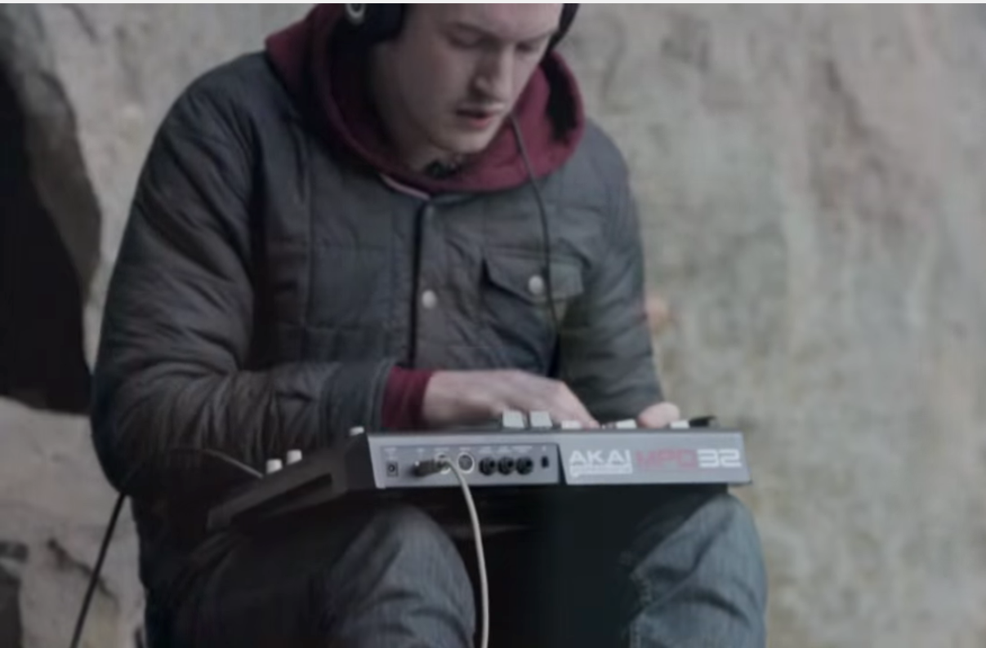
tIME:3:18
shot 18
Effects - Film Flare
Audio - Third Song ( Sample Song created for Video )
Script - B-Roll of Nature Hikes ( Desert Area )

Slide 20
tIME:3:29
Shot 19
Effects -
Audio - Third Song ( Sample Song created for Video )
Script - B-Roll of Nature Hikes ( Desert Area )

Slide 21
tIME:3:40
Shot 20
Effects - Fade to black after song
Audio - Third Song ( Sample Song created for Video )
Script - B-Roll of Nature Hikes ( Desert Area )

Slide 22
tIME:3:51
Shot 21
Effects - Cross Dissolve into video
Audio - Interview with Brendon Questions 10-15
Script - Video of Brendon in studio

Slide 23
tIME:4:02
shot 22
Effects -
Audio - Interview with Brendon Questions 10-15
Script - Video of Brendon in studio chair at desk

Slide 24
tIME:4:13
shot 23
Effects -
Audio - Interview with Brendon Questions 10-15
Script - Video of Brendon in studio close ups of him adjusting instruments

Slide 25
tIME:4:24
shot 24
Effects - Fade in from white
Audio - Brendon speaks about the instruments he uses
Script - Nature Video Clips with Brendon and his guitar

Slide 26
tIME:4:35
shot 25
Effects - Cross Dissolve
Audio - Brendon speaks about the instruments he uses
Script - Nature Video Clips with Brendon and his guitar ( Close Up )

Slide 27
tIME:4:46
shot 26
Effects - Cross Dissolve
Audio - Brendon speaks about the instruments he uses
Script - Nature Video Clips with Brendon and his guitar

Slide 28
tIME:4:57
shot 27
Effects - Fade in from Black
Audio - Brendon talking ( background audio of sample track )
Script - Brendon speaking about the theme of his music, Close ups of Brendon.

Slide 29
tIME:5:08
shot 28
Effects - Cross Dissolve
Audio - Brendon talking ( background audio of sample track )
Script - Brendon speaking about the theme of his music.

Slide 30
tIME:5:19
shot 29
Effects - Cross Dissolve
Audio - Brendon talking ( background audio of sample track )
Script - Brendon speaking about the theme of his music, Close ups of Brendon.

Slide 31
tIME:5:30
shot 30
Effects - Fade to black then Fade in from Black
Audio - Fade out sample song
Script - production credits fade in after Brendon track list for video and info about how to contact him.

Slide 32
tIME:5:30
shot 30
Effects - Fade to black then Fade in from Black
Audio - Tagline by Brendon
Script - production credits fade in after Brendon track list for video and info about how to contact him.

